Slide 1
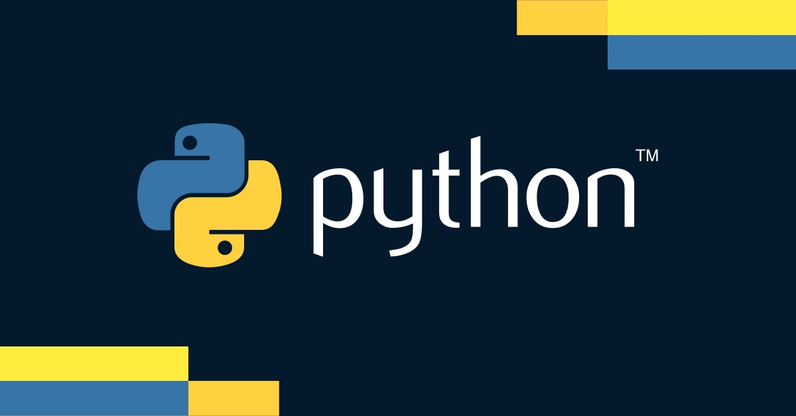

Slide 2

Working with
Modules

Slide 3
Importance of Date and Time Handling
Date and time handling is crucial for :
Scheduling and Time-Stamping
Essential for logging events, setting alarms, and scheduling tasks
Measuring Time Intervals
Used in performance measurement, countdowns, and time tracking
Formatting Dates for Display
Important for user interfaces, reports, and data export
Handling Time Zones
Critical for global applications to manage different time zones and daylight saving time

Slide 4
The datetime Module
The datetime module is part of Python's standard library
It provides classes to manipulate dates and times :
date
For working with dates (year, month, day)
time
For working with time (hours, minutes, seconds, microseconds)
datetime
For working with both dates and times
timedelta
For representing the difference between two dates or times
tzinfo
For dealing with time zones

Slide 5
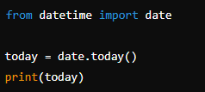

datetime.date Class
Represents a date (year, month, day)
Creating a Date Object
Accessing Date Attributes

Slide 6
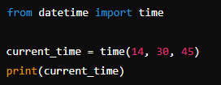

datetime.time Class
Represents time (hour, minute, second, microsecond)
Creating a Time Object
Accessing Time Attributes

Slide 7
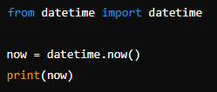
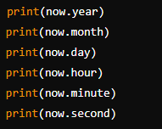

datetime.datetime Class
Represents both date and time
Creating a Datetime Object
Accessing Datetime Attributes

Slide 8

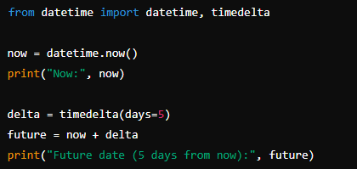

datetime.timedelta Class
Represents the difference between two dates or times
Creating a timedelta object
Code Example
Adding and subtracting dates

Slide 9

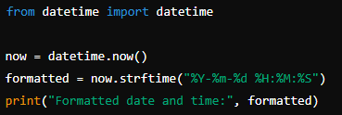
Formatting Dates and Times
Using strftime to format
Common format codes
%Y: Year with century
%m: Month as a zero-padded decimal number
%d: Day of the month as a zero-padded decimal number
%H: Hour (24-hour clock) as a zero-padded decimal number
%M: Minute as a zero-padded decimal number
Example
%S: Second as a zero-padded decimal number

Slide 10

What module in Python is used for working with dates and times?
datetime
How do you get the current date and time in Python using the datetime module?
datetime.datetime.now()
What method is used to format a datetime object into a string?
strftime()

Slide 11
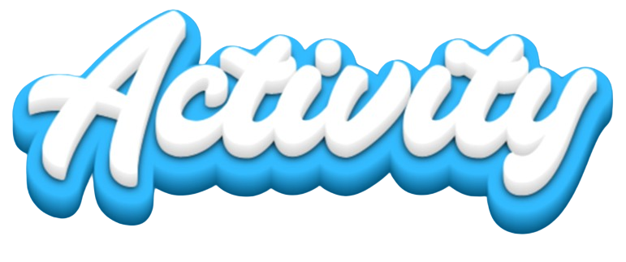
TASK 1
Write a Python script that prints the current date and time in the format YYYY-MM-DD HH:MM:SS.
TASK 2
Write a Python script that asks the user for their birthdate (in YYYY-MM-DD format) and calculates how many days are left until their next birthday

